Slide 1
Audio
Equipment

Slide 2
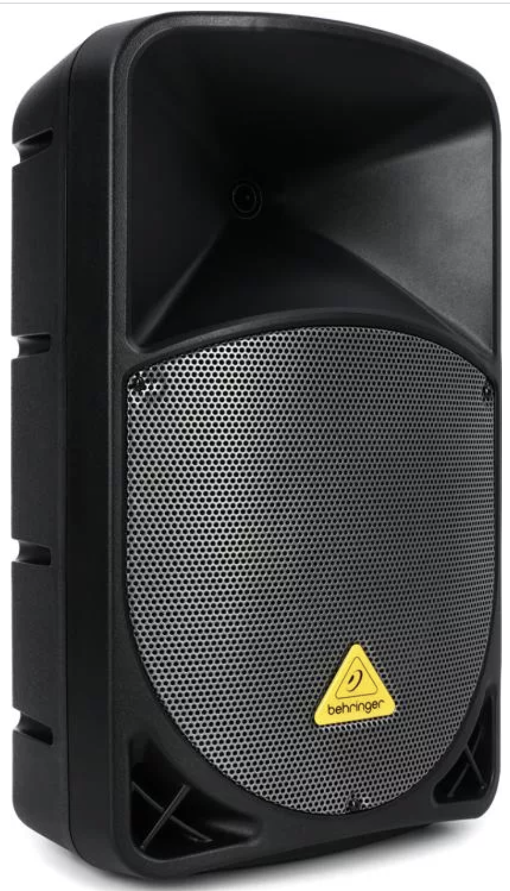
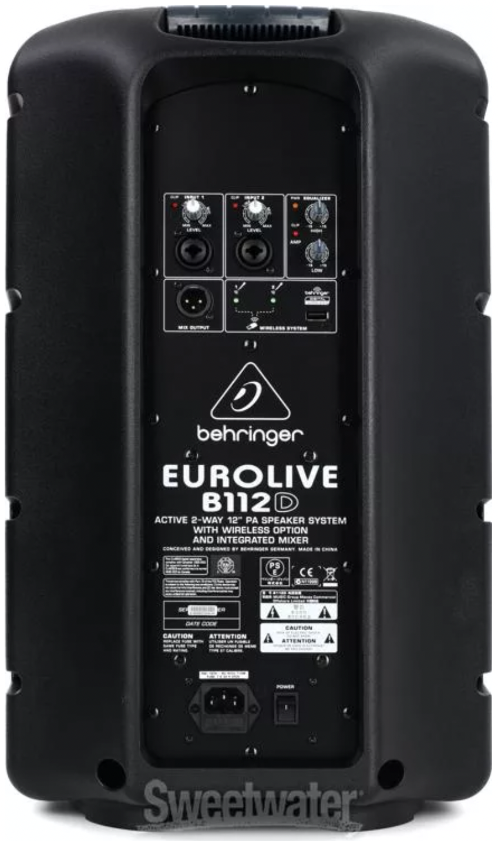
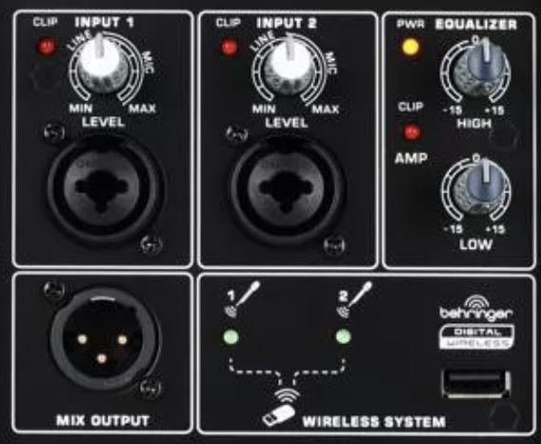
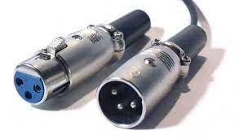
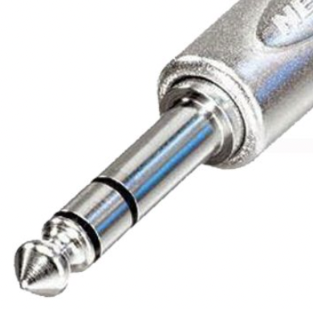
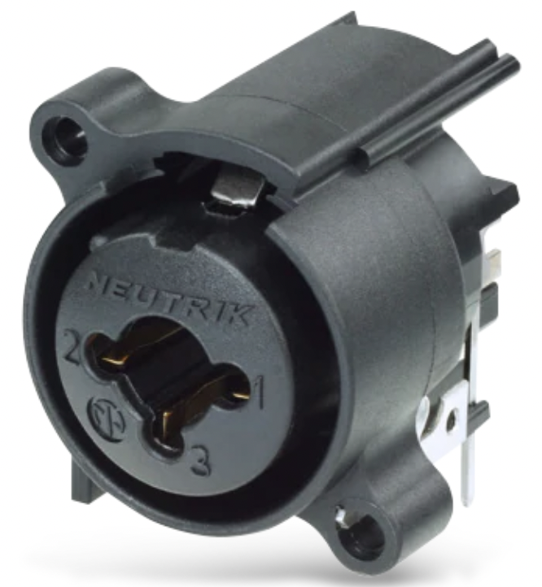
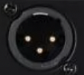
Behringer Eurolive B112D 1000W 12 inch Powered Speaker
Powered, Bi-amped, 1000W total power
LF Driver: 12", 700W
HF Driver: 1.35", 300W
Inputs: two XLR/TRS Combo connectors
Outputs: one XLR connector
Frequency Range: 50Hz-20Hz (-10dB)
Crossover Frequency: 2.8kHz
HxWxD = 22.4" x 13.4" x 10.6"
Weight: 27.1 lbs.
XLR Connector
TRS Connector
XLR/TRS Combo Connector

